Slide 1
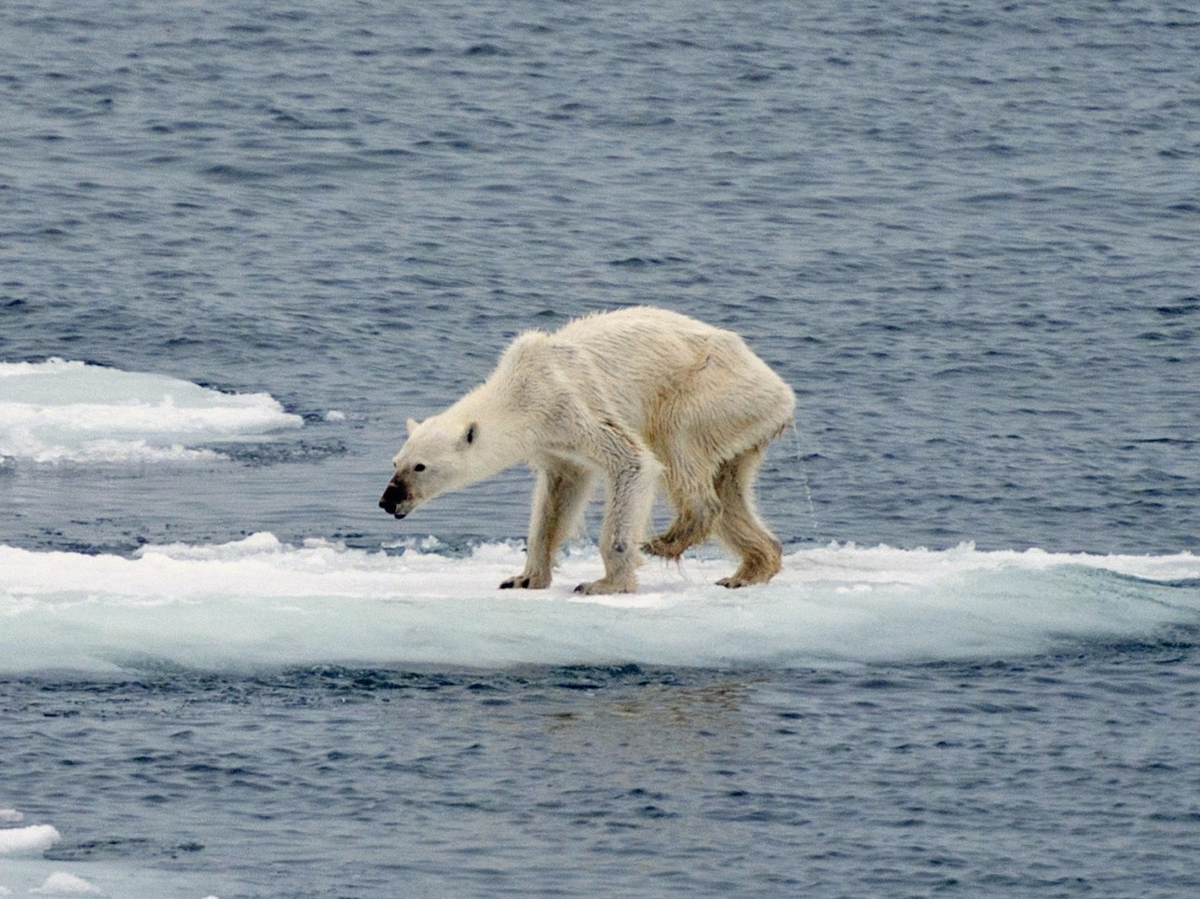
Are you aware of Climate Change?
Are you aware of
Climate Change?
Citizens For Our Children’s Future
Citizens For Our Children’s Future

Slide 2
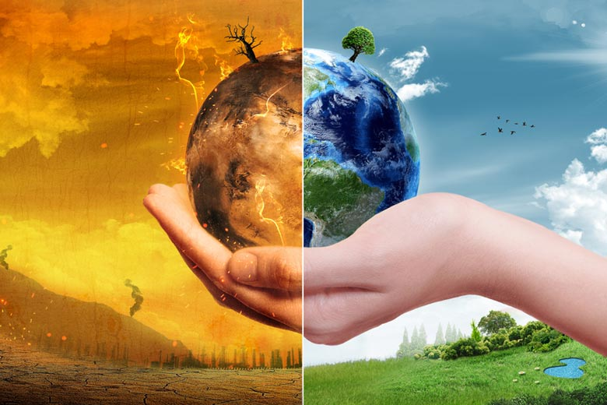
What is Climate Change?
Climate change includes warming, cooling and changes besides temperature to any long-term change in Earth's climate, or in the climate of a region or city.
Climate change, once considered an issue for a distant future, has moved firmly into the present.

Slide 3

Impacts On Senior Citizens
Heatwaves
Heatwaves can lead to severe heat strokes & dehydration in the elderly.
Air Pollution
The change in air quality can be a hard adjustment for older citizens especially those who grew up in a different climate.
New Diseases
Newer and more dangerous forms of animal, air and water borne diseases due to climate change leaves older adults more susceptible to being severely sick.

Slide 4

Long Term Human Impacts
Wide-ranging Health Impacts
Allergies and Asthma
Food and Waterborne Diarrheal Disease
Diseases Carried by Vectors

Slide 5

How Can You Help?
Chicago Climate Action Plan
Strategies
Energy Efficient Buildings
Clean and Renewable Energy
Improved Transportation Options
Reduced Waste & Industrial Pollution
Adaptation

Slide 6
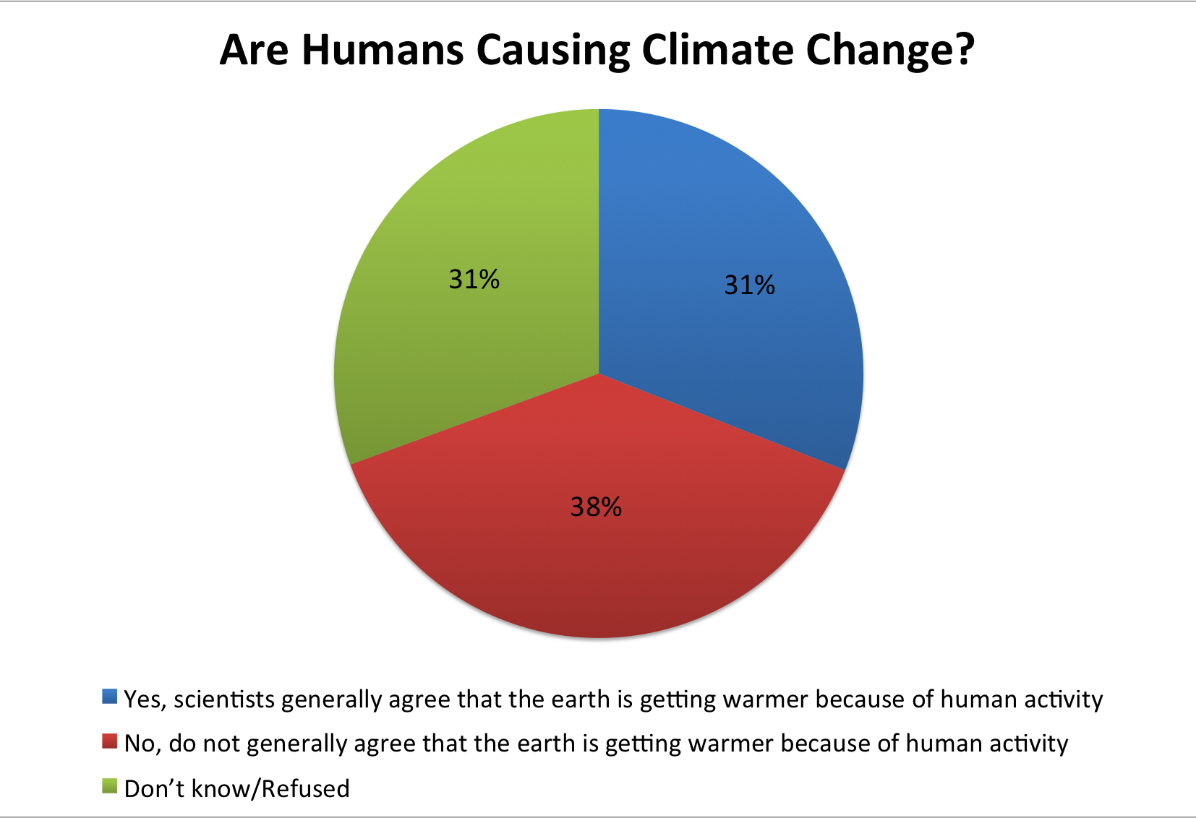
Pew study on attitudes toward Climate Change – The Whole Group Based

Slide 7
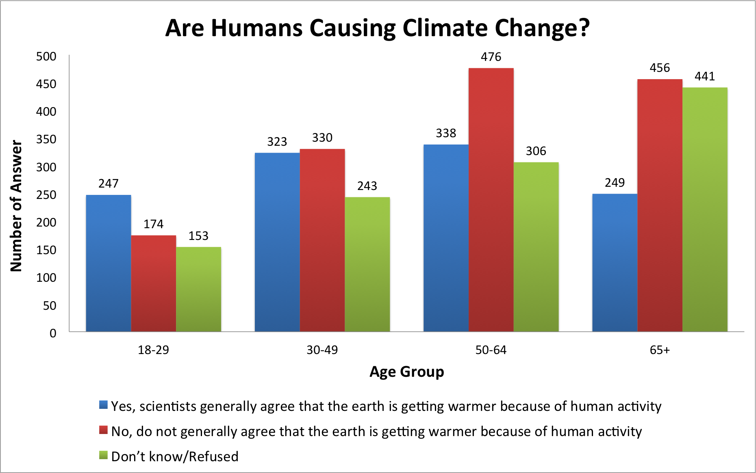
Pew study on attitudes toward Climate Change – Age Group Based

Slide 8

Did You Vote?
Find your representatives.
Register to vote.

Slide 9

Need More Information?
Visit our website to learn more about Climate Change.
You will also find step by step tutorials on:
How you can help.
How to find your representatives.
How to register to vote.
www.cfocf.org
Citizens For Our Children’s Future

Slide 10
Reference
Bednaršek, Tarling, G. A., Bakker, D. C. E., Fielding, S., Jones, E. M., Venables, H. J., … Murphy, E. J. National climate assessment. Retrieved December 8, 2016, from http://nca2014.globalchange.gov/highlights/overview/overview
Wall, J., & MSFC. (2015, June 9). What are climate and climate change? Retrieved December 8, 2016, from https://www.nasa.gov/audience/forstudents/5-8/features/nasa-knows/what-is-climate-change-58.html
Aging, G. H. (2016, March 10). How climate change affects the health of older adults. Retrieved December 8, 2016, from https://globalhealthaging.org/2016/03/10/how-climate-change-affects-the-health-of-older-adults/
Anderson, G., Krall, J. R., Peng, R. D., & Bell, M. L. (2011). National climate assessment. Retrieved December 8, 2016, from http://nca2014.globalchange.gov/highlights/report-findings/human-health
Reduced waste & industrial pollution. Retrieved December 8, 2016, from http://www.chicagoclimateaction.org/pages/reduced_waste___industrial_pollution/48.php
Retrieved December 8, 2016, from https://www.cityofchicago.org/content/city/en/depts/streets/supp_info/recycling1/find_a_residentialrecyclingdropoffcenter.html
City of chicago climate action plan. Retrieved December 8, 2016, from http://www.chicagoclimateaction.org/pages/what_you_can_do___make_a_difference/6.php

